Slide 1
Credit card fraud detection
Logistic Regression, Random Forest and XGBoost
Mentor:
prof. dr. Migdat Hodžić
Student:
Zorka Kunovac

Slide 2
Content:
Business understanding
Data understanding
Data preparation
Modeling
Evaluation and Deployment
Conclusion

Slide 3
Business understanding
Credit card frauds are one of the most common fraud type
Banks invest huge amount of time and money in the security of their systems
Credit card companies should recognize fraudulent credit card transactions so that customers are not charged for items that they did not purchase
The goal is to detected fraudulent credit card transactions

Slide 4
Data understanding
The dataset contains transactions made by credit cards in September 2013 by European cardholders
Dataset has 284807 observations and 31 columns.
Features V1, V2, … V28 are the principal components obtained with PCA, the only features which have not been transformed with PCA are 'Time' and 'Amount‘.
Target feature is 'Class' and it takes value 1 in case of fraud and 0 otherwise.

Slide 5
Data preparation
Project code is written in Google Colab
Python
Supervised learning
Code is separated into four sections:
Data preprocessing
Building the model
Final Model
Predicting a single observation

Slide 6
Data preparation
Data preprocessing
Building the model
Data exploration
Dealing with missing values
Encoding categorical data
Countplot
Correlation matrix and heatmap
Splitting the dataset
Feature scaling
Logistic Regression
Random Forest
XGBoost Classifier
Cross validation

Slide 7
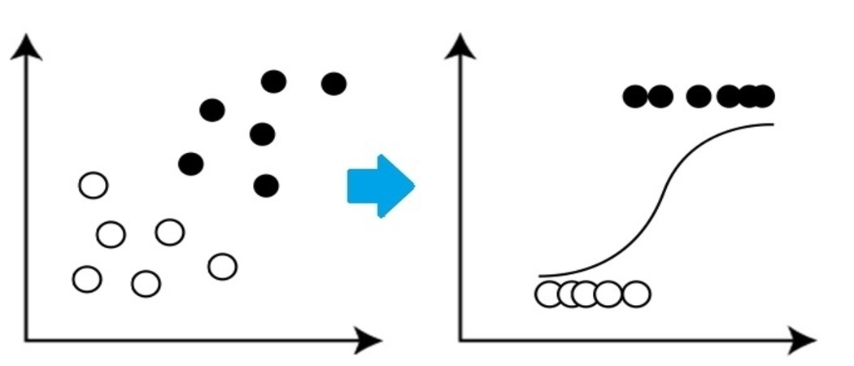
Modeling
Performance
Logistic regression
Accuracy score
F1 score
Precision
Recall
Confusion Matrix

Slide 8
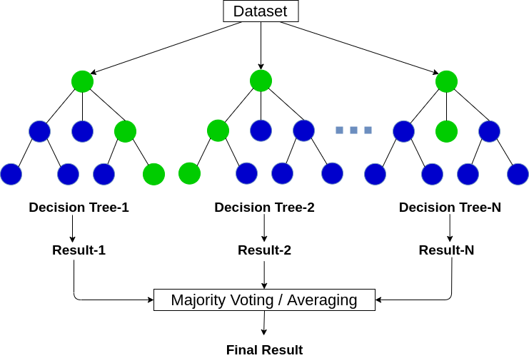
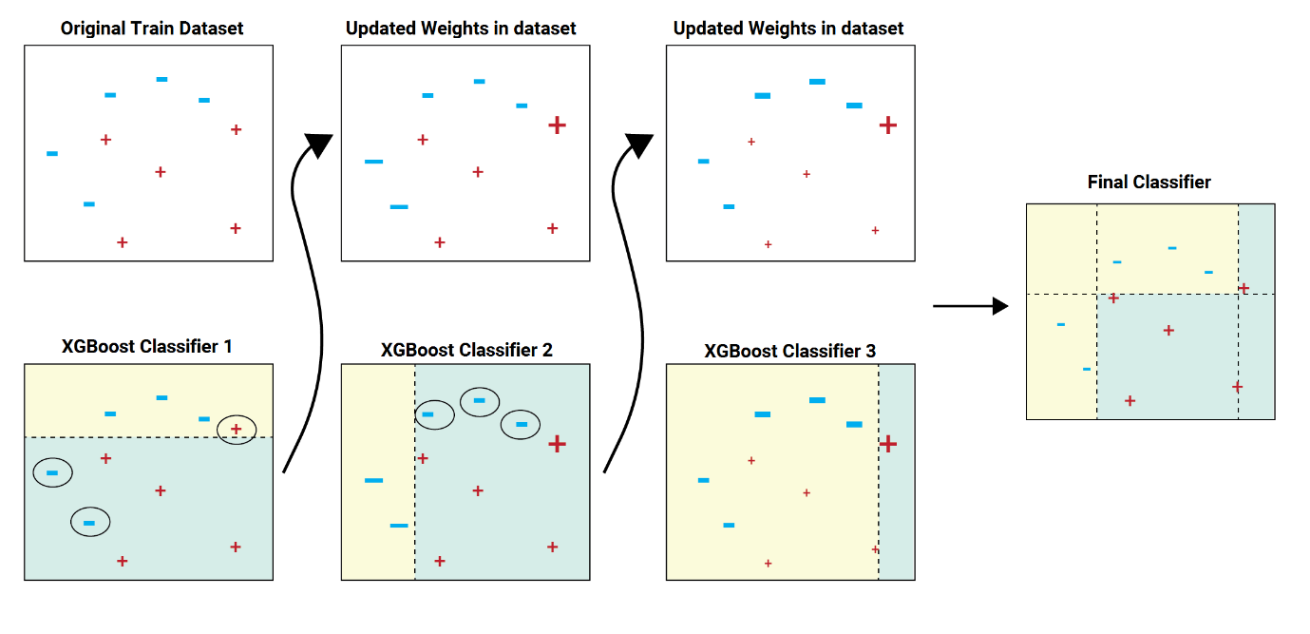
Modeling
Random Forest
XGBoost

Slide 9
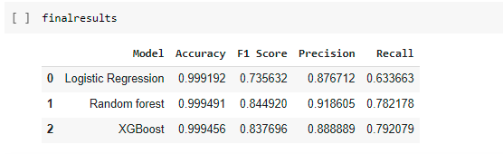
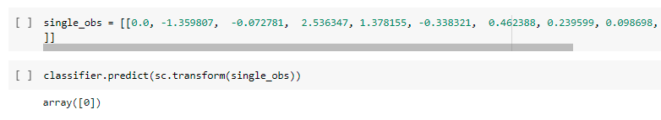
Evaluation and deployment
Final results
Predicting a single observation

Slide 10
Conclusion
Good performance and quality
Avoids the overfitting problem
Gives better prediction when compared with a single model
Computation time is high

Slide 11
Thanks for watching!
Questions?

